Slide 1
I/O Board
FPGA Board

Slide 2
VSCode (VHDL Editor)
iCEcube2 (VHDL compiler)
Alchitry Loader (programmer)
I/O Board + FPGA Board
USB Serial connection
Programming
interface

Slide 3
I/O Expanders
Led[0]
LED indicators
led[0 – 7]
USB serial interface
Interface 0: programming
Interface 1: FPGA GPIO
EEPROM
FPGA binary
FPGA Board
Lattice iCE40-HX8K
CB132 package
100 MHz clock

Slide 4
I/O Board
DIP input switches
io_swt_a[0 – 7]
io_swt_c
io_swt_b
io_swt_a

Slide 5
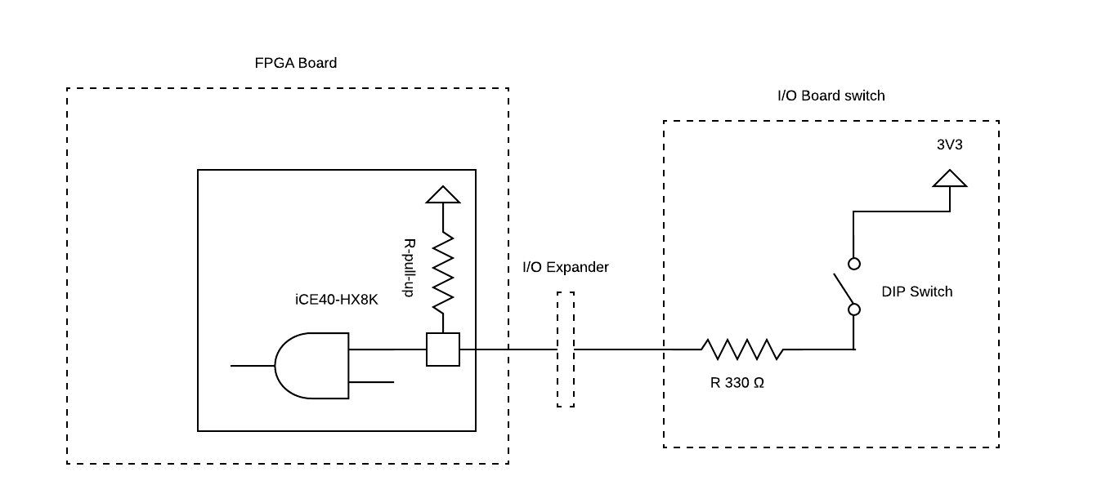
iCE40 IO block
(no pull-downs, only pull-up)
DIP switch circuit
I/O board
io_swt_a, b, c

Slide 6
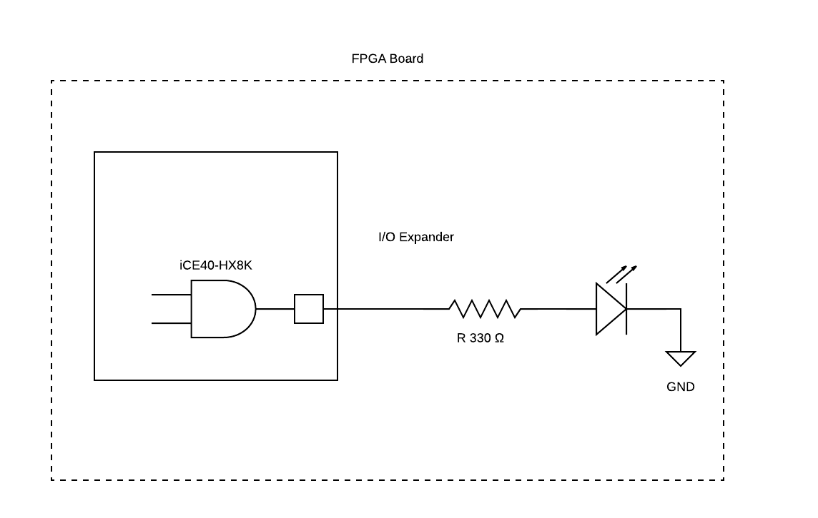
LED circuit
FPGA board
Led[0 to 7]

Slide 7
iCE40 FPGA
Tutorial.vhd
implementation
LED outputs
FPGA board
Led[0..7]
I/O board
DIP Switch A
io_swt_a[0..7]
Led[0..7]

Slide 8
Tutorial.vhd
I/O board
DIP Switch A
io_swt_a[0..7]
pulldown.vhd
LED outputs
FPGA board
Led[0..7]
clk_in
Led[0..7]

